Slide 1
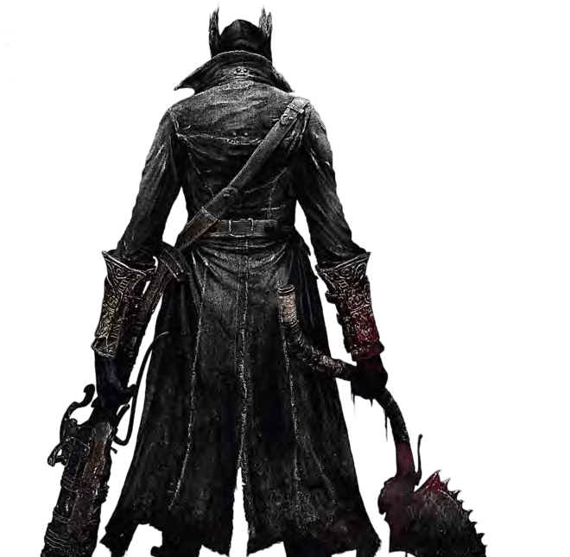
Bloodborne: The Card Game
A Game overview by Adam King, Ethan Wade, and Jacob McElhannon

Slide 2
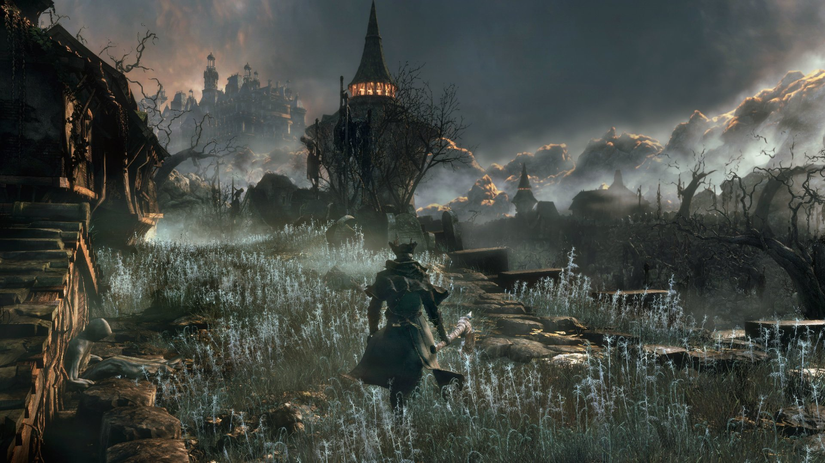
What is Bloodborne?
Bloodborne is an action-RPG released in 2015 and developed by FromSoftware, the makers of Dark Souls.
The game’s content focuses on strategic and deliberate combat, rich RPG elements, punishing difficulty, and a rich world to explore.
The Card and Board game versions of Bloodborne carry on with the tradition of complex systems and easy-to-learn, hard-to-master gameplay.
Photo credit (bottom): Adam King

Slide 3
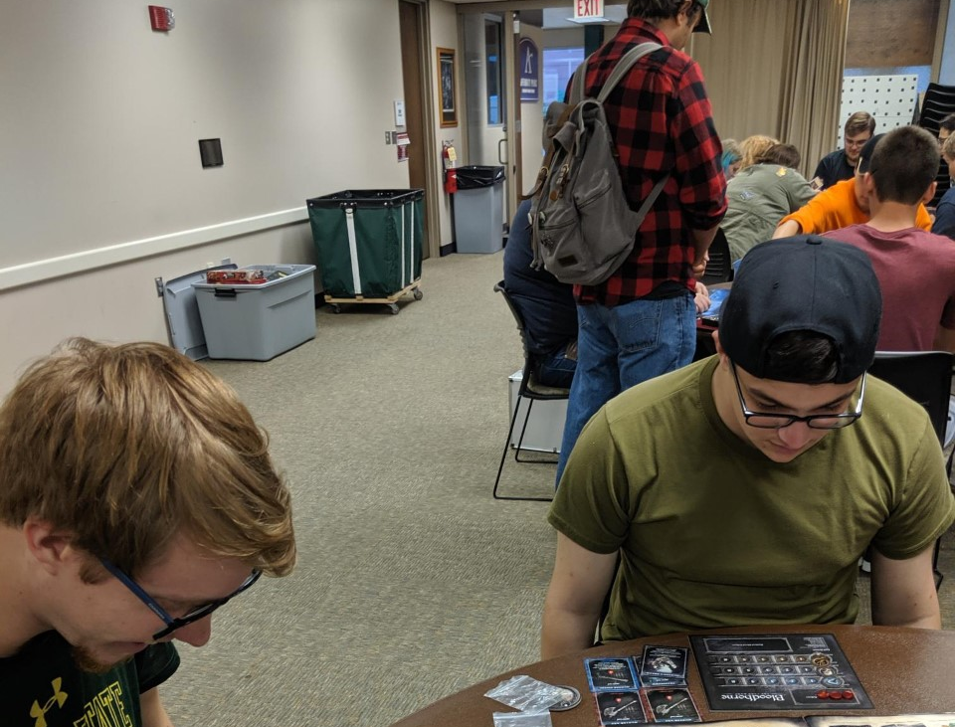
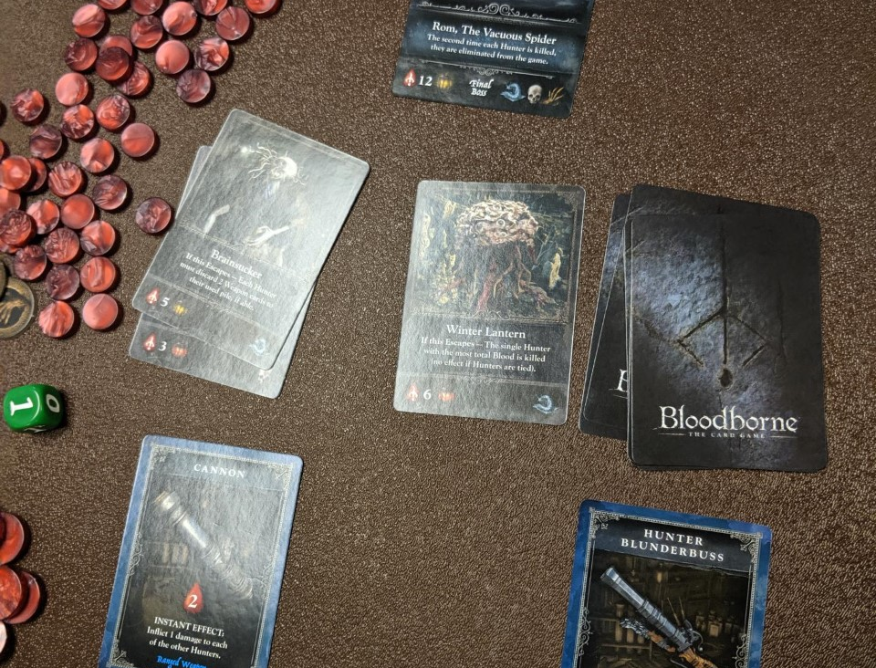
The Goal of the Game
All players work together to fight through the Chalice Dungeons against a variety of monsters with different statistics, as well as strong Boss Monsters. After all monsters are defeated, a Final Boss is faced by the group.
Meanwhile, as players work together to defeat enemies, they earn Blood Echoes which serve as both a currency and as a win condition. They can be spent to buy better Action Cards, or can be ‘saved’, so you will not lose them if your player dies. If you have a large total of saved Blood Echoes and/or Trophies earned from defeating monsters, you will win if you have the most saved out of the team.
Each player has a Health Dial that totals 8 life points. If you run out of health, you lose all unsaved Blood Echoes and cannot attack that round. You revive on the next turn.
The players also have a hand limit of 7 cards each. If you draw and exceed this limit, you must discard a card of your choice.
Photo credit: Adam King

Slide 4
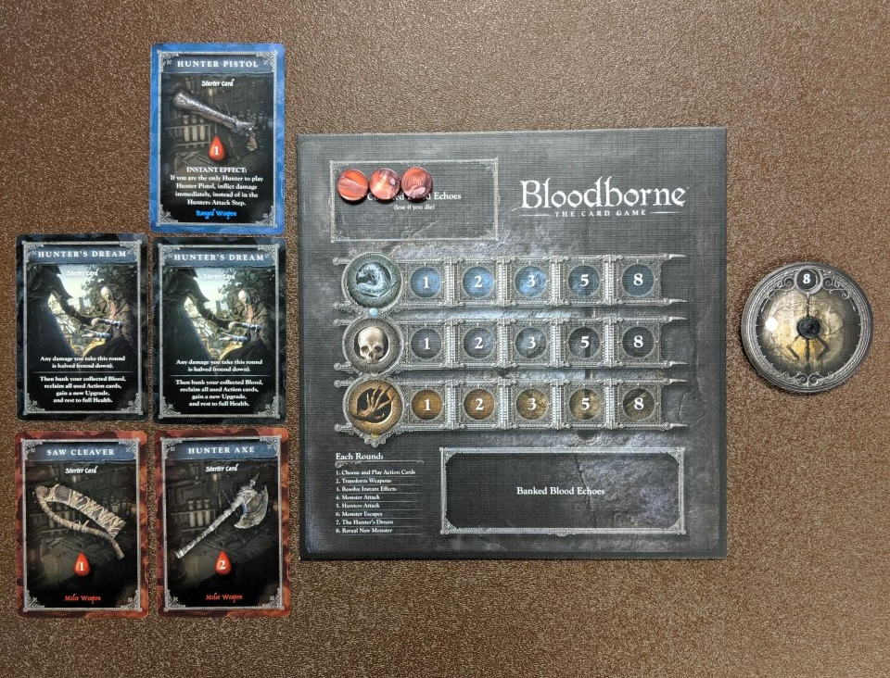
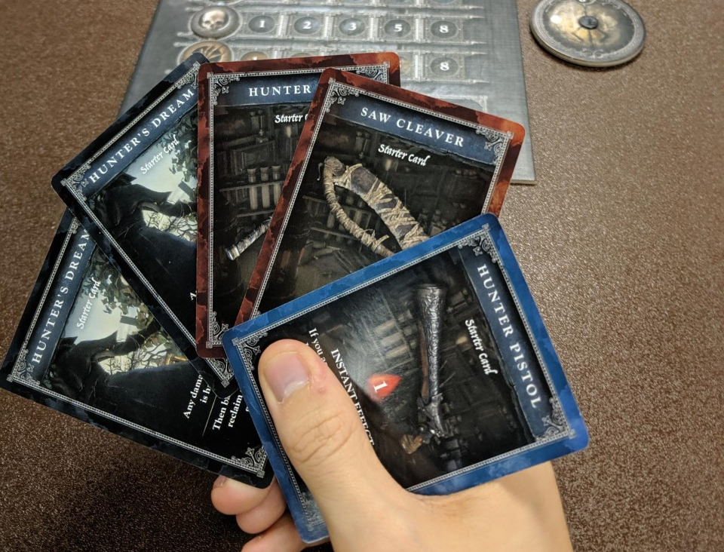
The Hunters’ Board and Action Cards
The Hunter’s Board is the primary zone where all your key info is displayed to you. It displays your current freshly-earned Blood Echoes, your saved ones, as well as counters related to Trophies that you earn when you defeat Monster Cards of the corresponding Monster types.
Action Cards represent weapons, items, and useful abilities that each player can use to fight monsters or help/hinder other players. New Action Cards can be purchased with spare Blood Echoes on your turn if the player decides to return to the Hunter’s Dream during his or her turn.

Slide 5
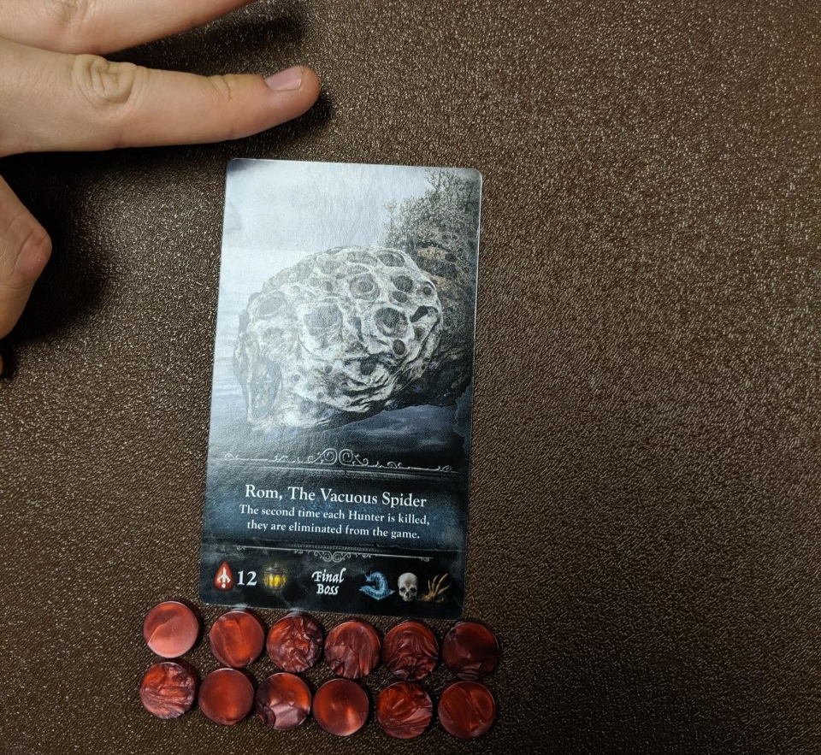
The Monsters and Final Boss
Monster Cards are drawn when the previous Monster was destroyed or has fled and have different health points, monster types, and damage types. Additionally, they may have special abilities listed on the card. There are three damage types, with green being the weakest, yellow being in the middle, and red being the most devastating. When a monster attacks, its color’s dice is cast, and that damage amount is applied to all players.
Boss Monster cards have much more health and have at least two monster type Trophy awards. These powerful monsters also have a special ability that activates when they enter the field and is forced upon all players.

Slide 6
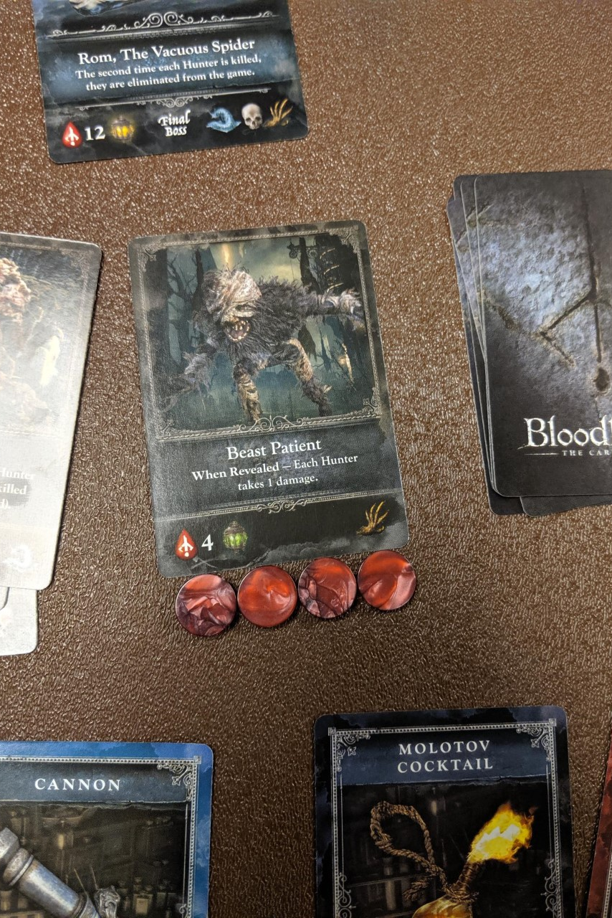
Initial Setup Stage
There are a few initial steps taken to prep the players for the game.
The Final Boss Card deck is shuffled and one of them is selected at random.
7 random Monster Cards are drawn and 3 Boss Cards are selected. These are shuffled together to become the Monster Deck. Place in center of play space.
Weapon Upgrade cards are shuffled and placed in the middle of play space. As are the Blood Echo Tokens.
Each Player takes a Hunter’s Board. They also take 1 each of the different Starter Cards and set their Health Dials to 8.
Lastly, the first player is chosen by the group, and the first Monster Card is revealed, starting the game.

Slide 7
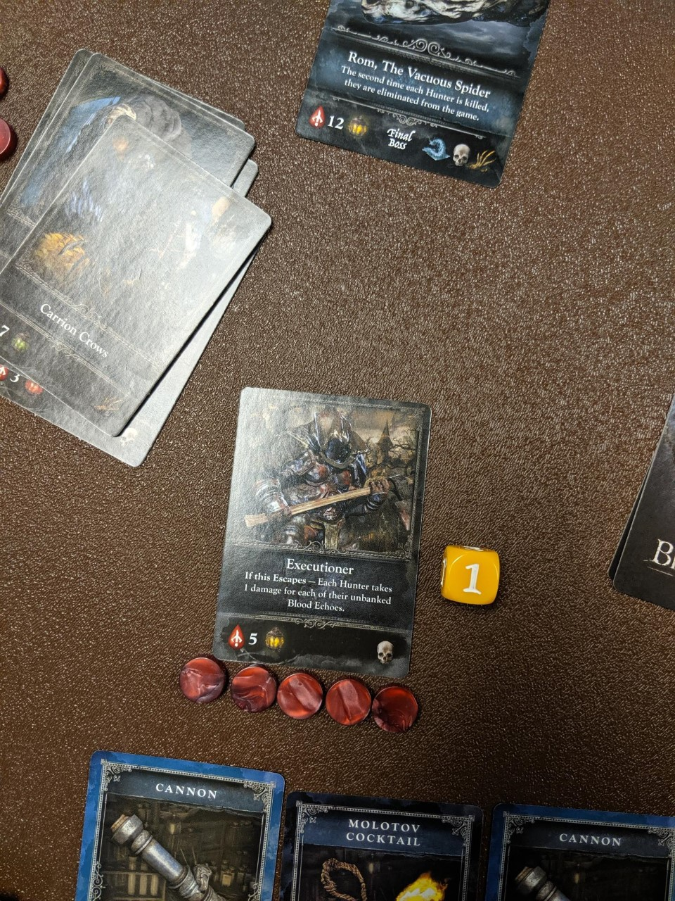
Progression of a Turn: 1 and 2
First: In the first step of a game, all players will choose a Starter Action Card from their hand, and simultaneously all players will reveal the cards they decided to play. Those who play a gun-type Action Card that explicitly states that it has priority can attack the active Monster Card earlier than others (in the third step), but only if they were the only player to play a gun-type card that round. All others must wait for the Attack Phase (step five) in order to battle the Monster.
Second: If a player decided to place down a Transform Card in order to evaluate the Action Cards of other players, they must use this time to ‘transform’ their card into another Action Card from their hand. This can be used to counterattack a tricky player, or perhaps to place a gun down and get some early damage in for easy Blood Echoes.

Slide 8
Progression of a Turn: 3-5
Third: If a player had played a gun-type card that explicitly states that it goes first in the first step, or had a card with an instant effect, that ability is played now.
Fourth-Monsters Attack: In this stage, the First Player rolls the colored dice that corresponds to the color of monster being played. That damage that is rolled is granted to all players. If the dice number has a + sign next to it, then that damage is dealt plus another roll’s worth. With red Monsters, this can lead to potentially endless combos. If a player dies from this, they lose all Blood Echoes not saved, and cannot attack in the next step.
Fifth-Players Attack: Depending on the Action Card that was played at the beginning of the turn, each player deals the damage listed on that card to the Monster. They can take that same amount in Blood Echoes and add them to their temporary Blood Echo storage. If the Monster is defeated in this stage, each player earns a Trophy of that Monster’s type. However, if the Monster was not defeated in this stage…..

Slide 9
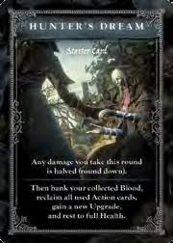
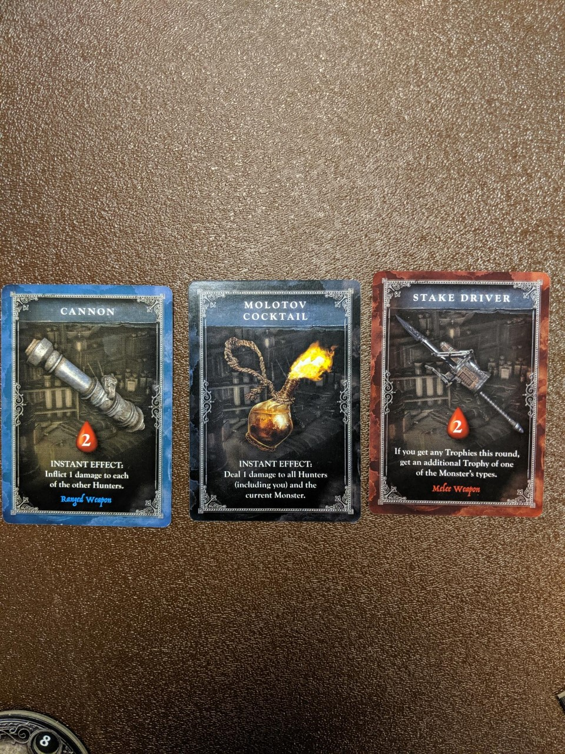
Progression of a Turn: 6-7
Sixth: …Then that Monster will escape from the game area on Step Six. When a Monster escapes, no one earns Trophies or Blood Echoes, unless they had previously damaged the creature. The only Monster that will not run away is a mini-Boss Monster, these must be fully defeated before they will leave the field.
Seven: In the first step, if a player played an Action Card called the Hunter’s Dream (pictured top right), they may essentially, ‘go back to base’ and get some R&R. Their Health Dial recharges to 8 points, all collected Blood Echoes are saved in the Blood Echo Storage, you may choose an Upgrade Action Card (pictured at right) and add it to your hand, and you reclaim all discarded Action Cards as well! This can be a highly advantageous card to use after you’ve gathered up a lot of Blood Echoes, as well as prior to a mini-boss or Final Boss fight.
At the end, choose the new First Player, discard Action Cards, and draw a new Monster Card! Replay until the Final Boss is reached and defeated.

Slide 10
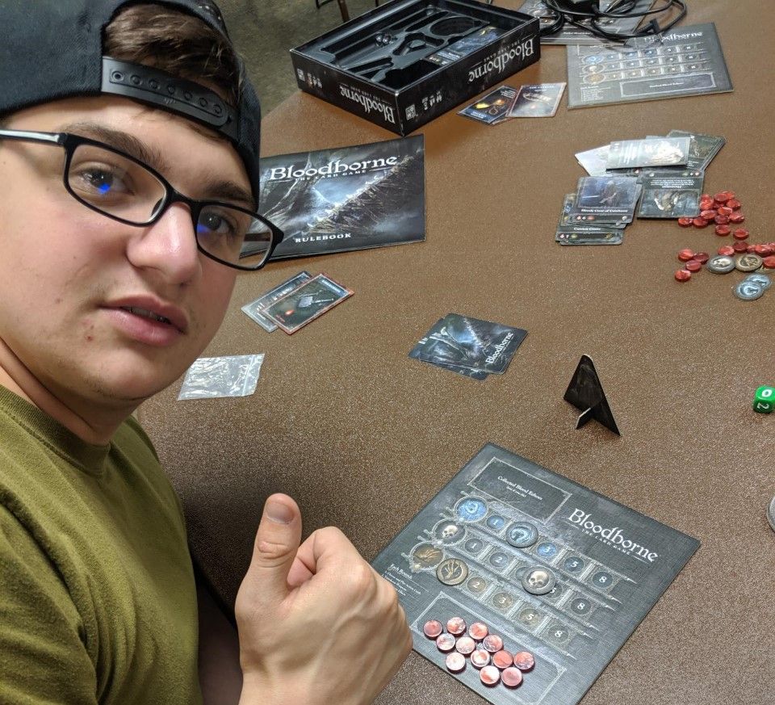
The Winner
With a total of 12 saved Blood Echoes, 2 Kin Trophies, 4 Human Trophies, and 1 Beast Trophy, Jacob won the game with 19 total points!

Slide 11
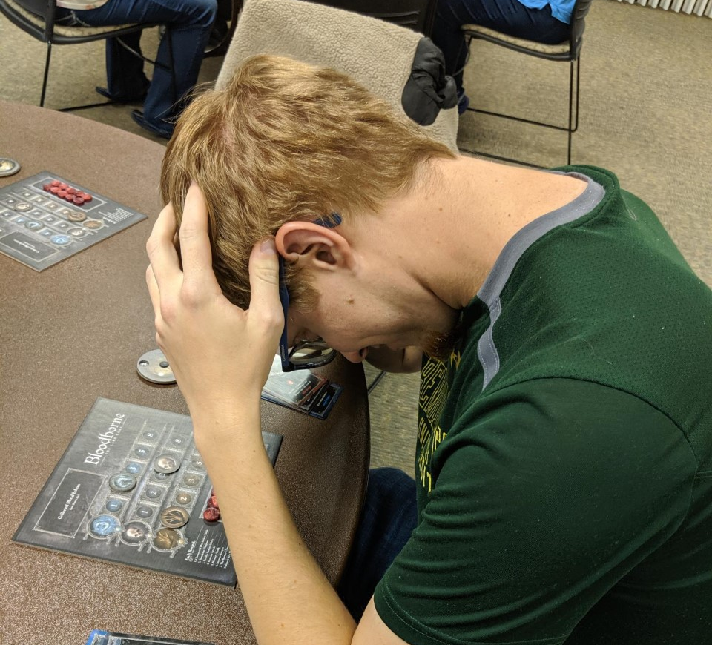
The Losers
Adam and Ethan were not as fortunate.

Slide 12
Sources
Photos: https://www.cleanpng.com/png-dark-souls-demon-s-souls-bloodborne-the-witcher-3-828149/download-png.html / https://vignette.wikia.nocookie.net/vsbattles/images/3/3a/Bloodborne-the-old-hunters-two-column-01-ps4-us-06oct15.png/revision/latest/scale-to-width-down/400?cb=20160826161536 / https://images2.alphacoders.com/532/thumb-1920-532523.jpg
Rulebook: https://cmon-files.s3.amazonaws.com/pdf/assets_item/resource/43/Bloodborne_Rulebook__2_.pdf

