Slide 1
Keyflower

Slide 2
The Rules
Each player starts with a home tile and 8 "meeples" in red, yellow, or blue
In the first season, Spring, players use their meeples to bid on tiles to add to their home or on ships

Slide 3
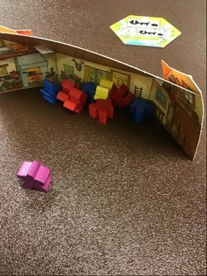
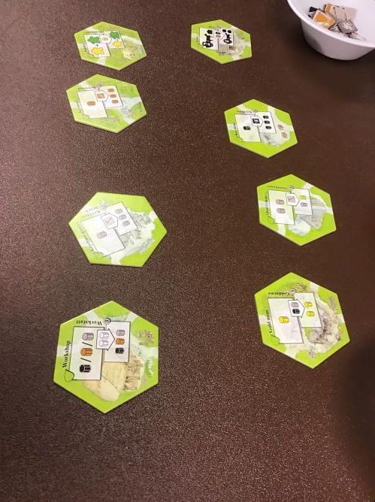

Slide 4
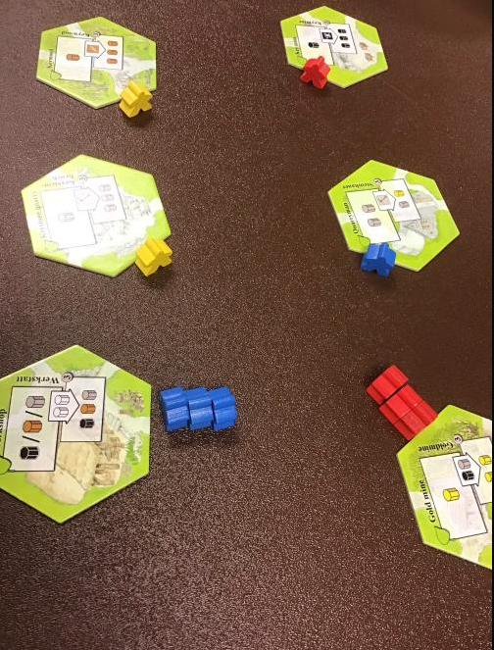
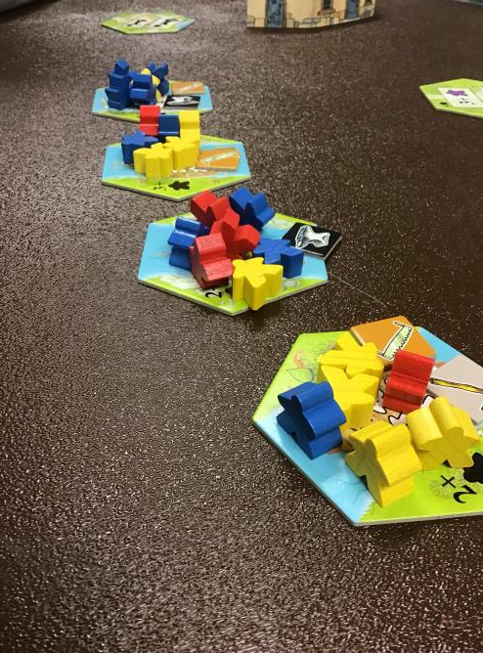

Slide 5
More Rules
When you bid, other players can only bid with that color of meeple
A season ends when all of the players pass (when everyone has nothing left to do)
During winter, players put out special tiles they were given at the beginning of the game to bid on
Also bid on empty ships
The end goal is to get as many points as possible (through tiles you win)

Slide 6
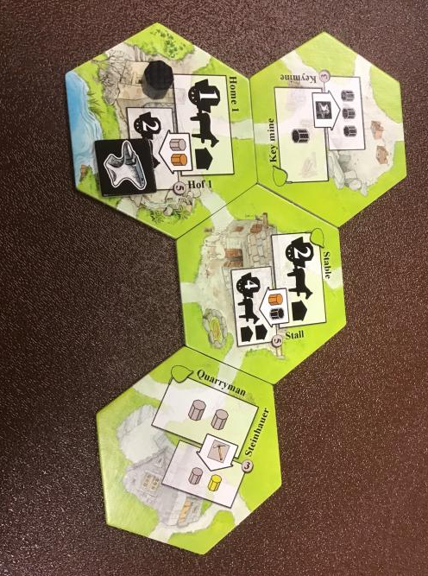
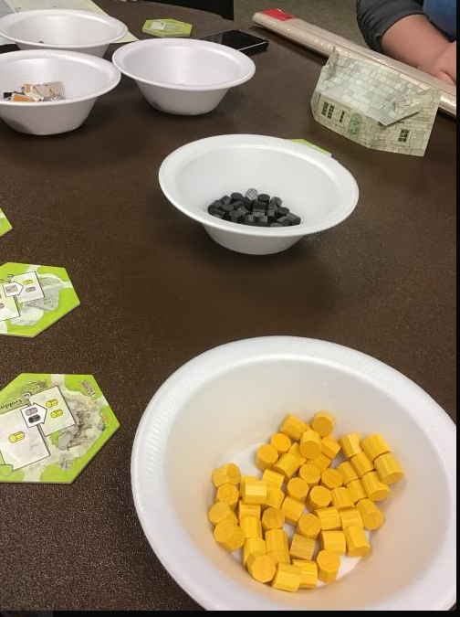

Slide 7
Class Tie-ins
Competitive
End Goal (winner)
Complicated
Has a story
Fun to play (in our opinion)

Slide 8
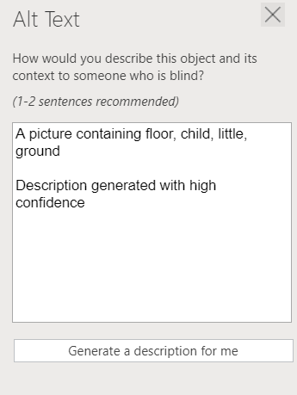
Text generation for picture of meeples in the house

